Slide 1


COVID-19 DEMYSTIFIED
We simplify Deep Tech through courses and consultancy
©2020 learn-tech.io
Notes:
I’m Mike Lloyd, Founder of learn-tech
We simplify deep tech through courses and our clients include Pearson and Microsoft
We’ll give you the address for the COVID-19 Demystified course at the end of the session
But I also suggest that you connect with me on LinkedIn to for pointers to the course and relevant articles – search for Mike Lloyd, Founder learn-tech.
I’m joined here today by Gareth James, one of the course writers, who will join me in taking questions later.

Slide 2
COVID-19 Demystified Team
Dr Kethakie Lamahewa, Epidemiologist
Gareth James, Medical Statistics Consultant
Dr Siobhan Crichton, Clinical Trials Statistician
Dr Ransika De Silva, ICU Clinician
Lorna Conlon M.P.S.I., Pharmacist
Donna Buckley, Mathematics Educator
Barry Kissane, Mathematics Educator
Mike Lloyd, Technologist
Photo by Markus Spiske on Unsplash
©2019 learn-tech.io
Notes:
COVID-19 DM was written by experts for non-experts – the general public and secondary level students and above.
It’s a STEM course with a strong hands-on element
Written by a core team of 8 people, + 6 reviewers.
5 core team from Medical world, epidemiology, stats, and clinical practice
2 maths educators
1 technologist
It’s a joint UK and Australian project

Slide 3
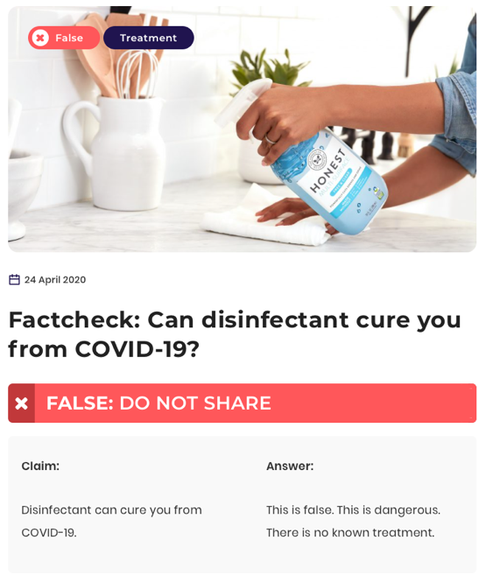
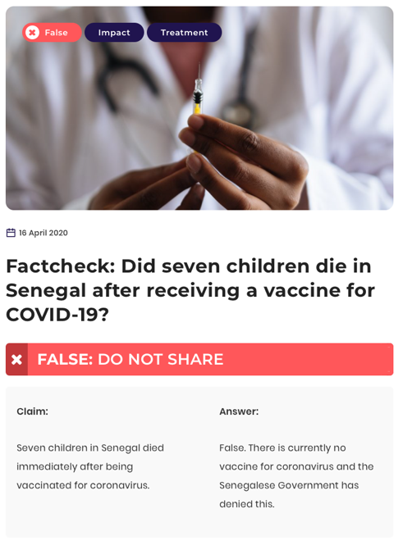
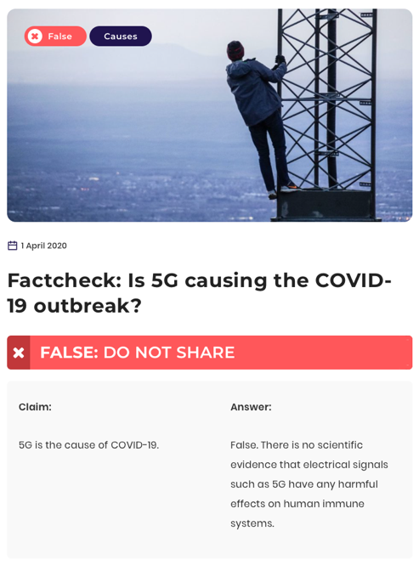
Why COVID-19 Demystified?
We now have two enemies to fight – the virus and misinformation
https://infotagion.com
©2019 learn-tech.io
Notes:
This project came about when a highly distressed woman appeared on the BBC saying that her husband was on a ventilator and she had no idea what a ventilator was.
Since then its become clear that we are fighting two enemies – the virus itself, and misinformation
COVID-19 misinformation now has as much reach as the BBC, Guardian, New York Times, and Washington Post combined.
Public discourse about COVID-19 now has two main features:
Fear
Blame
Take a look at infotagion.com to see some of the astonishing claims that are being made on social media.
Some claims are outright silly
Other claims – especially those related to unproven treatments, vaccination and emergency calls are life-threatening
So, our goal with this project is to put a scientific and mathematical framework around the pandemic, and give users the tools to make their own minds up – but based on facts and statistics
https://www.linkedin.com/feed/update/urn:li:activity:6660118895074115584/
https://www.oii.ox.ac.uk/blog/misinformation-and-the-coronavirus-resistance/

Slide 4
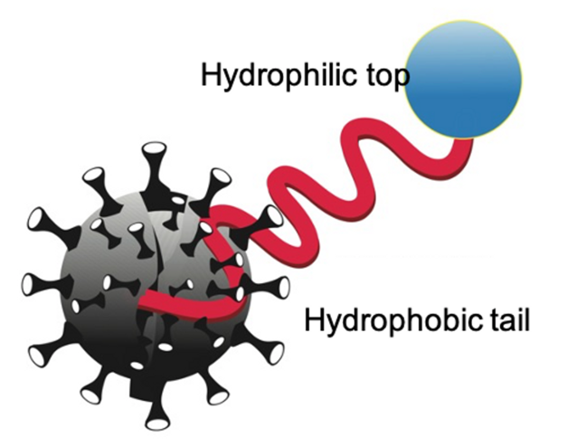
What You Will Learn?
STEM for non-experts, and secondary school students and above
What is SARS-CoV-2 and COVID-19?
What can we do about it?
Hands-on modelling different policy effects
Photo by Markus Spiske on Unsplash
©2019 learn-tech.io
Notes:
The course starts with an exploration of the science behind COVID-19.
We look in detail at how viruses work and why SARS-CoV-2 can do so much damage in the human body.
We then look in detail at what we can do about it.
For example, why is soap so effective?
Why is social distancing so important?
What is the role of drugs and vaccines in stopping the pandemic?
What equipment can be used to keep people safe and fight the disease?
We then look at the range of options that governments and health authorities have for fighting the pandemic and explain how basic Epidemiology models work, and how they can be used to support decision-making.
Here, we address questions such as
What is the “R’ number
What is an SIR model?
How can you predict if a health system would become overwhelmed or not?
We aim to put structured analysis of policies and their effects into the hands of the learners.
To do this we provide and Excel workbook with a range of models that the users can input their own data into.
These models build in complexity, so we gently take users along a structured learning path.
Finally, we explore ways of exiting the pandemic, and what measures can be taken too return us to normality.

Slide 5

Feedback To-Date
”Given my passion for mathematical modelling, STEM and authentic problem based learning this hits every point."
Rachael Whitney-Smith
Curriculum Specialist for Mathematics
©2019 learn-tech.io

Slide 6
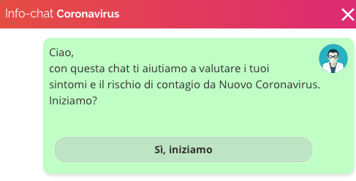
AI vs COVID-19 - Detection and Diagnosis
University of Southampton analysed mobile phone data from China to understand the pandemic’s early movement patterns
Infervision –
CT scans analysis
Bluedot used web scraping + NLP to predict spread of the virus
Paginemediche telediagnosis - chatbot
Photo by Markus Spiske on Unsplash
©2019 learn-tech.io
Notes:
https://www.bbc.co.uk/news/technology-52120747v
https://www.vox.com/recode/2020/2/7/21125959/artificial-intelligence-coronavirus-benevolent-ai-treatment
Photo by Jorick Jing on Unsplash

Slide 7
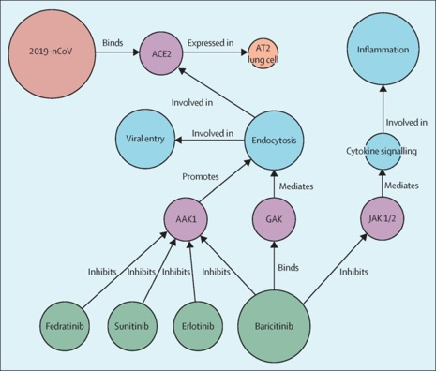
AI vs COVID-19 - Finding a Cure.
BenevolentAI applied knowledge graph to searching through literature for existing drugs, based on SARS-CoV-19’s chemical properties.
Deep Mind AlphaFold – find the shape of SARS-CoV-2 protein through pattern finding
Insilico Medicine – GAN type approach to computer generated drug models.
©2019 learn-tech.io
Notes:
https://www.bbc.co.uk/news/technology-52120747v
https://www.vox.com/recode/2020/2/7/21125959/artificial-intelligence-coronavirus-benevolent-ai-treatment
https://www.stevens.edu/news/novel-molecule-could-spur-new-class-drugs-breast-cancer

Slide 8
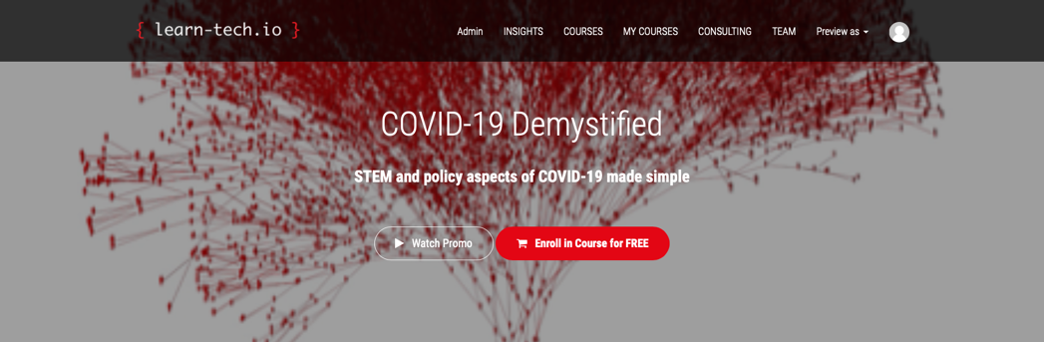
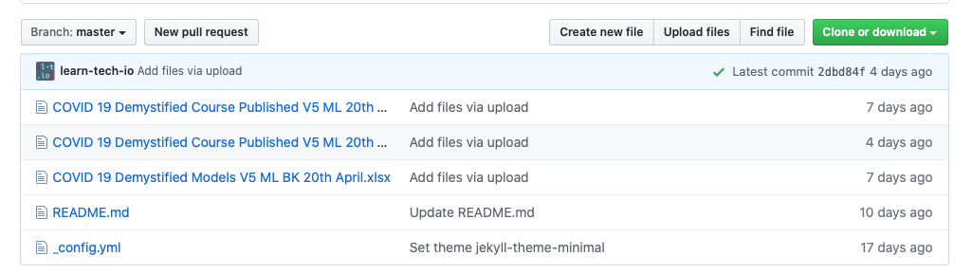
Accessing the Course
Web course - https://www.learn-tech.courses/p/covid-19-demystified
GitHub - https://github.com/learn-tech-io/covid-19-demystified
©2019 learn-tech.io

